Slide 1
Solid State Physics Tutorial II (DOS, Effective Mass, Velocity in bands)
Engineering Physics

Slide 2
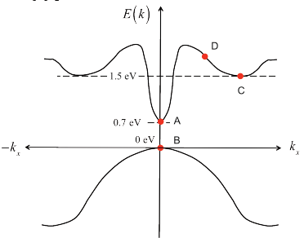
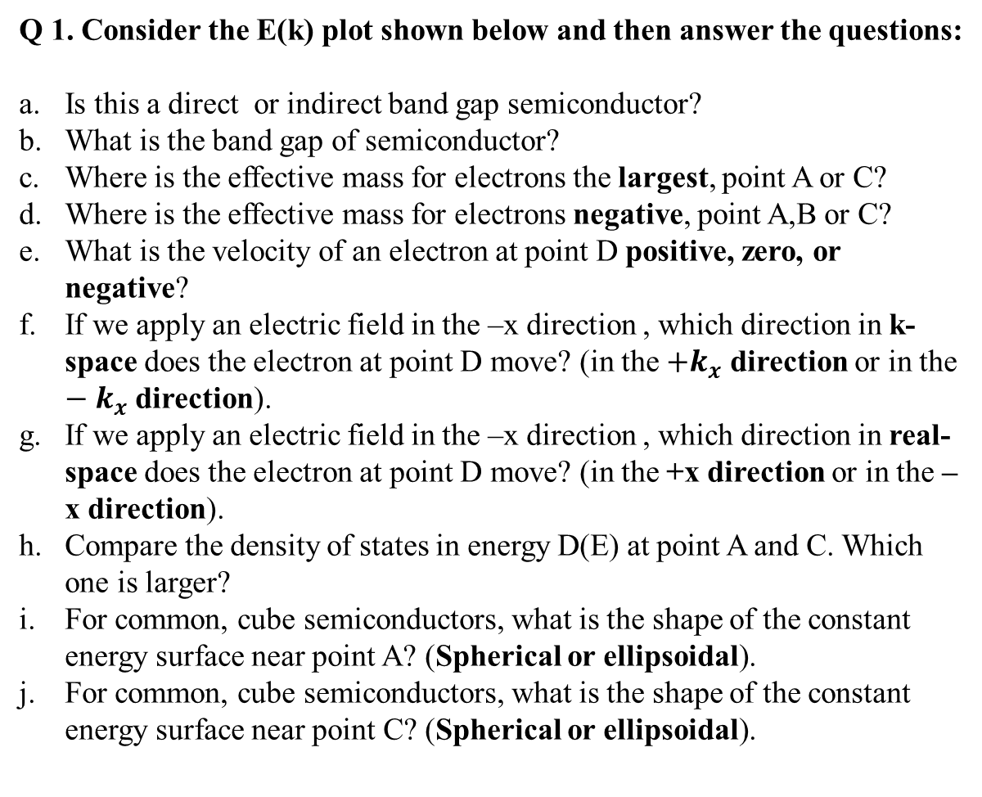
Q 1. Consider the E(k) plot shown below and then answer the questions:
Is this a direct or indirect band gap semiconductor?
What is the band gap of semiconductor?
Where is the effective mass for electrons the largest, point A or C?
Where is the effective mass for electrons negative, point A,B or C?
What is the velocity of an electron at point D positive, zero, or negative?
If we apply an electric field in the –x direction , which direction in k-space does the electron at point D move? (in the $+k_{x}$ direction or in the $−k_{x}$ direction).
If we apply an electric field in the –x direction , which direction in real-space does the electron at point D move? (in the +x direction or in the – x direction).
Compare the density of states in energy D(E) at point A and C. Which one is larger?
For common, cube semiconductors, what is the shape of the constant energy surface near point A? (Spherical or ellipsoidal).
For common, cube semiconductors, what is the shape of the constant energy surface near point C? (Spherical or ellipsoidal).

Slide 3
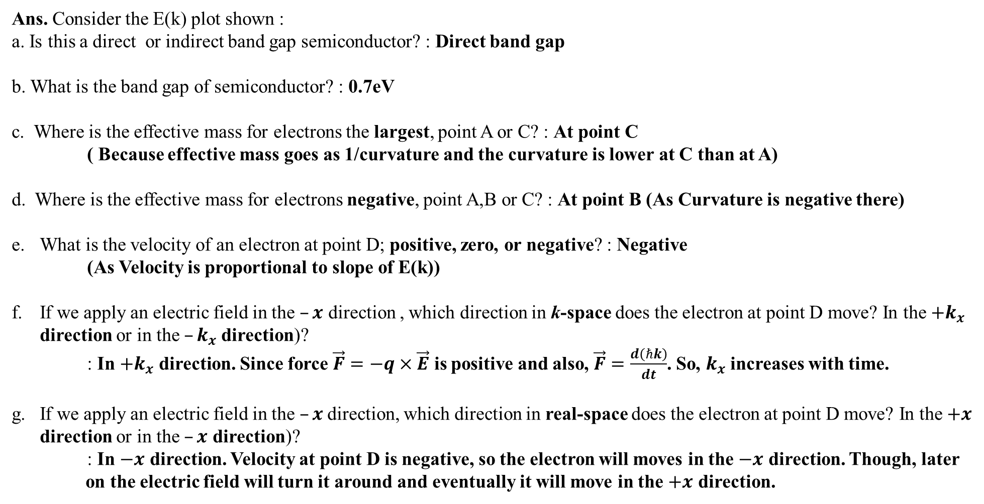
Ans. Consider the E(k) plot shown :
a. Is this a direct or indirect band gap semiconductor? : Direct band gap
b. What is the band gap of semiconductor? : 0.7eV
c. Where is the effective mass for electrons the largest, point A or C? : At point C ( Because effective mass goes as 1/curvature and the curvature is lower at C than at A)
d. Where is the effective mass for electrons negative, point A,B or C? : At point B (As Curvature is negative there)
What is the velocity of an electron at point D; positive, zero, or negative? : Negative (As Velocity is proportional to slope of E(k))
If we apply an electric field in the $–x$ direction , which direction in k-space does the electron at point D move? In the $+k_{x}$ direction or in the $–k_{x}$direction)?
: In $+k_{x}$ direction. Since force $\vec{F}=−q×\vec{E}$ is positive and also, $\vec{F}=\frac{d\left(ℏk\right)}{dt}$. So, $k_{x}$ increases with time.
If we apply an electric field in the $–x$direction, which direction in real-space does the electron at point D move? In the $+x$ direction or in the $–x$ direction)?
: In $−x$ direction. Velocity at point D is negative, so the electron will moves in the $−x$ direction. Though, later on the electric field will turn it around and eventually it will move in the $+x$ direction.

Slide 4
h. Compare the density of states in energy D(E) at point A and C. Which one is larger?
: DOS is larger at point C. Because D(E) is proportional to mass to some power (depending on 1D, 2D and 3D). So, bigger mass means bigger DOS].
i. For common, cube semiconductors, what is the shape of the constant energy surface near point A? (Spherical or ellipsoidal).
: Spherical
j. For common, cube semiconductors, what is the shape of the constant energy surface near point C? (Spherical or ellipsoidal).
: Ellipsoidal

Slide 5
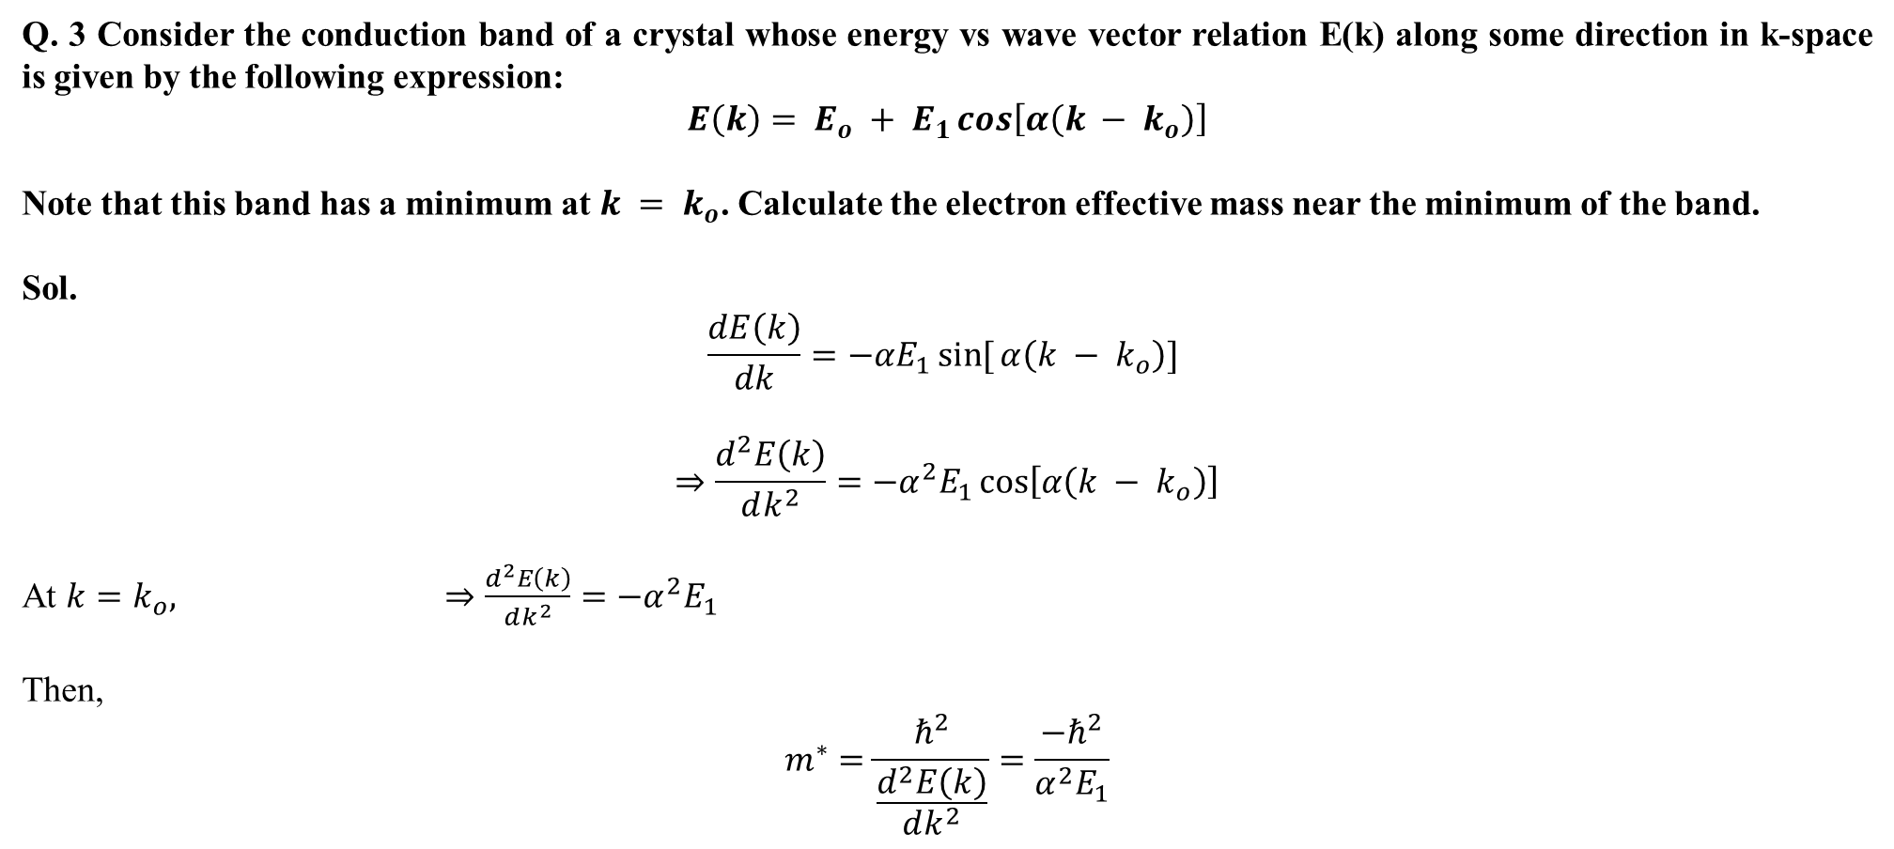
Q. 3 Consider the conduction band of a crystal whose energy vs wave vector relation E(k) along some direction in k-space is given by the following expression:
$$E\left(k\right)= E_{o} + E_{1}\cos\left[α\left(k − k_{o}\right)\right]$$
Note that this band has a minimum at $k = k_{o}$. Calculate the electron effective mass near the minimum of the band.
Sol.
$$\frac{dE\left(k\right)}{dk}=−αE_{1}\sin{[}α\left(k − k_{o}\right)]$$
$$⇒\frac{d^{2}E\left(k\right)}{dk^{2}}=−α^{2}E_{1}\cos\left[α\left(k − k_{o}\right)\right]$$
At $k=k_{o},$ $⇒\frac{d^{2}E\left(k\right)}{dk^{2}}=−α^{2}E_{1}$
Then,
$$m^{∗}=\frac{ℏ^{2}}{\frac{d^{2}E\left(k\right)}{dk^{2}}}=\frac{{−ℏ}^{2}}{α^{2}E_{1}}$$

Slide 6
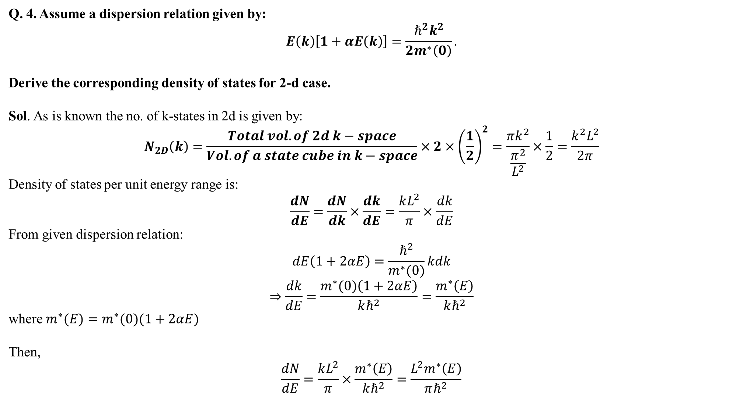
Q. 4. Assume a dispersion relation given by:
$$E\left(k\right)\left[1+αE\left(k\right)\right]=\frac{ℏ^{2}k^{2}}{2m^{∗}\left(0\right)}.$$
Derive the corresponding density of states for 2-d case.
Sol. As is known the no. of k-states in 2d is given by:
$$N_{2D}\left(k\right)=\frac{Total vol. of 2d k−space}{Vol. of a state cube in k−space}×2×{\left(\frac{1}{2}\right)}^{2}=\frac{πk^{2}}{\frac{π^{2}}{L^{2}}}×\frac{1}{2}=\frac{k^{2}L^{2}}{2π}$$
Density of states per unit energy range is:
$$\frac{dN}{dE}=\frac{dN}{dk}×\frac{dk}{dE}=\frac{kL^{2}}{π}×\frac{dk}{dE}$$
From given dispersion relation:
$$dE\left(1+2αE\right)=\frac{ℏ^{2}}{m^{∗}(0)}kdk$$
$$⇒\frac{dk}{dE}=\frac{m^{∗}(0)\left(1+2αE\right)}{kℏ^{2}}=\frac{m^{∗}\left(E\right)}{kℏ^{2}}$$
where $m^{∗}(E)=m^{∗}(0)(1+2αE)$
Then,
$$\frac{dN}{dE}=\frac{kL^{2}}{π}×\frac{m^{∗}\left(E\right)}{kℏ^{2}}=\frac{L^{2}m^{∗}\left(E\right)}{πℏ^{2}}$$

Slide 7
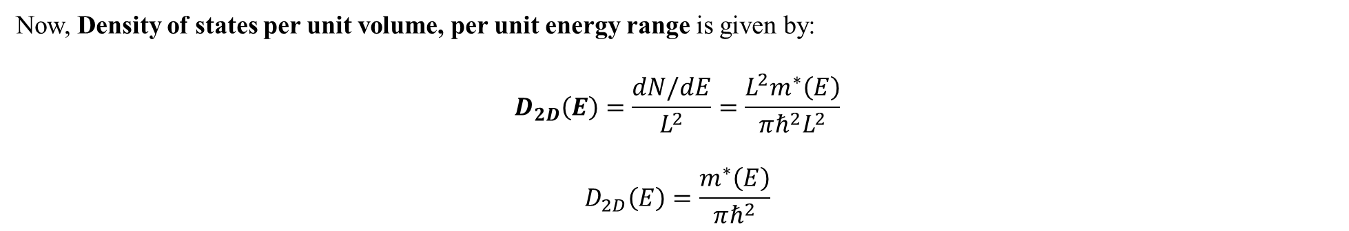
Now, Density of states per unit volume, per unit energy range is given by:
$$D_{2D}\left(E\right)=\frac{dN/dE}{L^{2}}=\frac{L^{2}m^{∗}\left(E\right)}{πℏ^{2}L^{2}}$$
$$D_{2D}\left(E\right)=\frac{m^{∗}\left(E\right)}{πℏ^{2}}$$

Slide 8
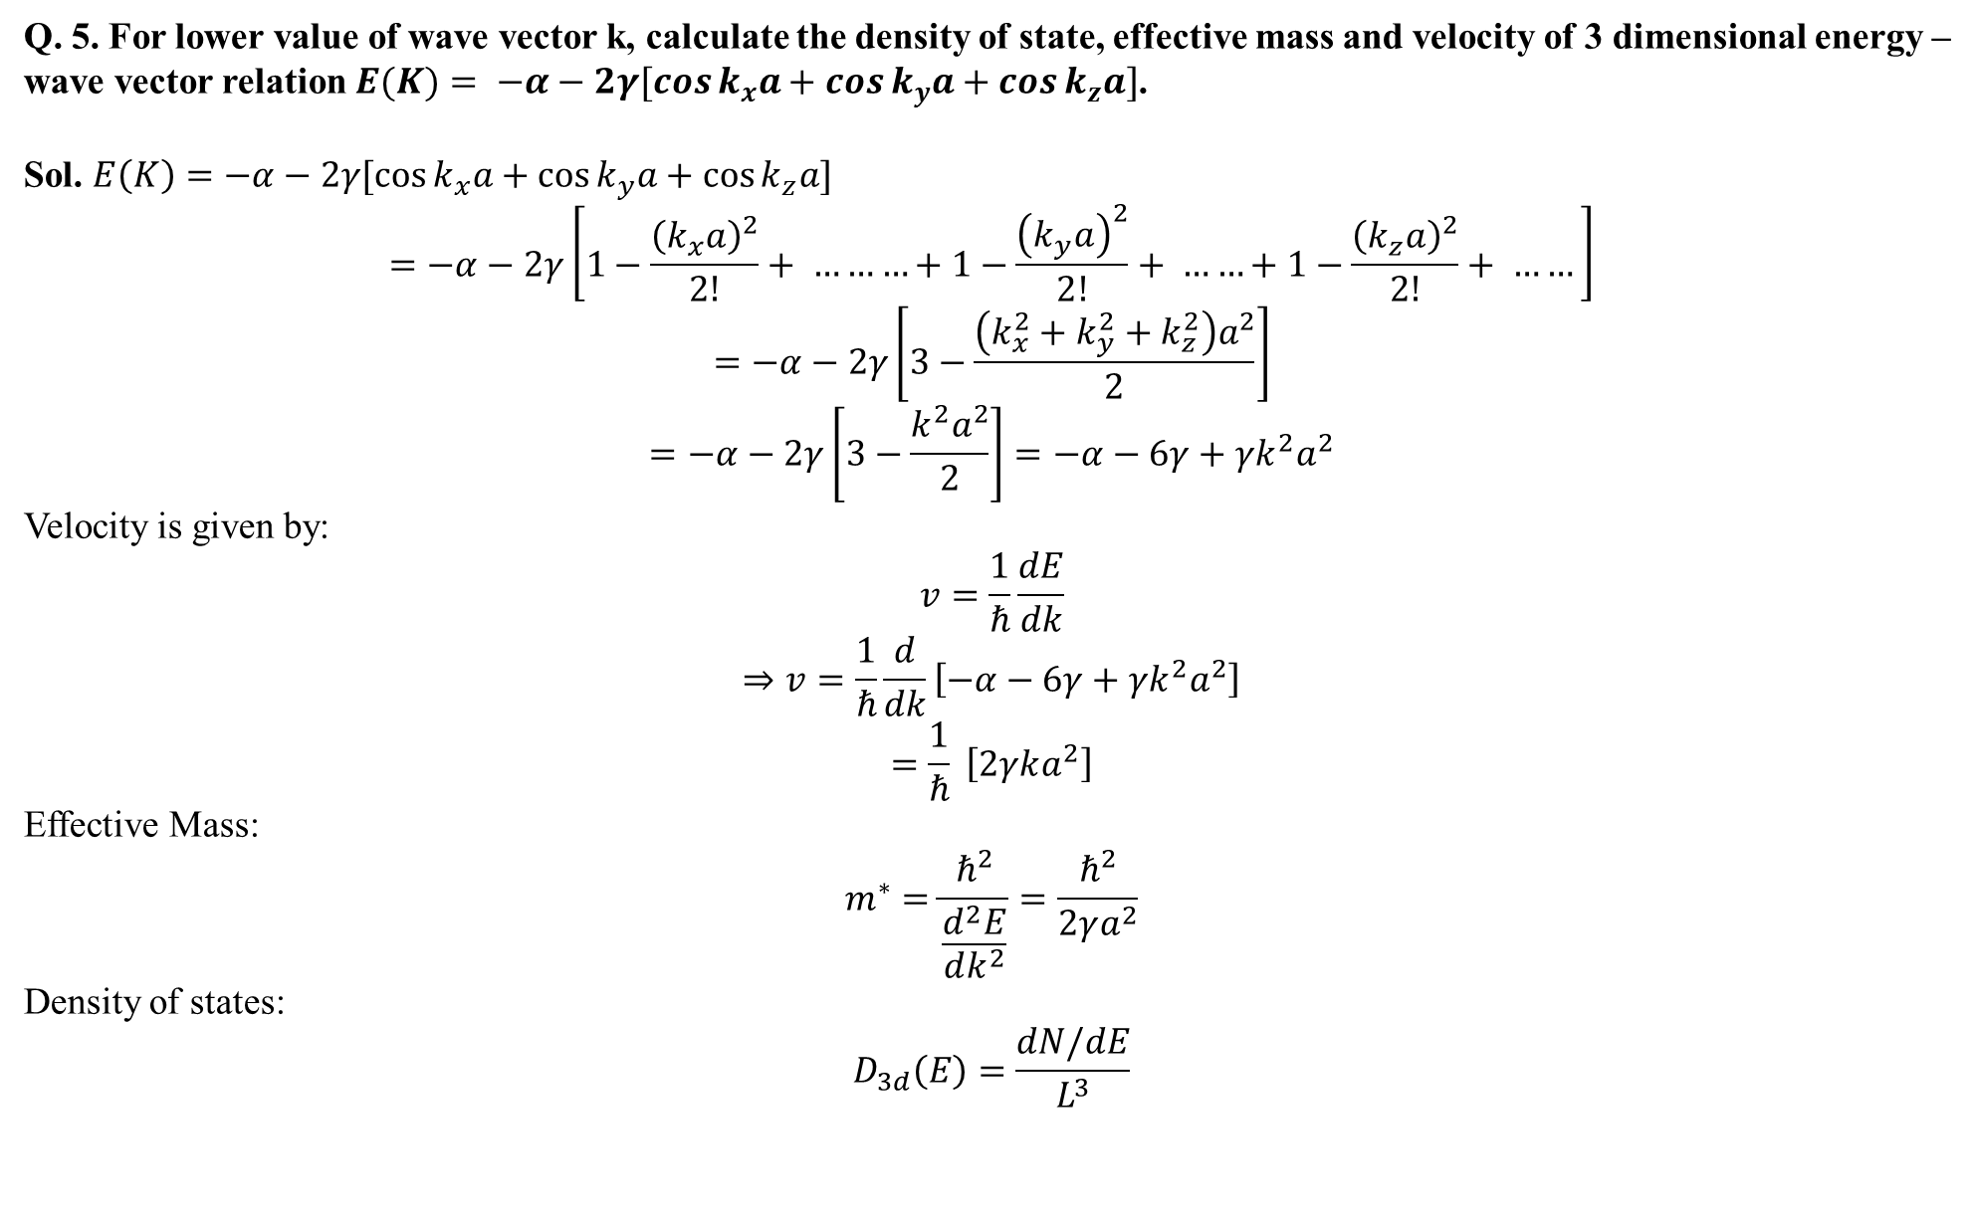
Q. 5. For lower value of wave vector k, calculate the density of state, effective mass and velocity of 3 dimensional energy –wave vector relation $E(K)= −α−2γ[\cos{k_{x}a}+\cos{k_{y}a}+\cos{k_{z}a}]$.
Sol. $E\left(K\right)=−α−2γ[\cos{k_{x}a}+\cos{k_{y}a}+\cos{k_{z}a}]$
$$=−α−2γ\left[1−\frac{{\left(k_{x}a\right)}^{2}}{2!}+ ………+1−\frac{{\left(k_{y}a\right)}^{2}}{2!}+ ……+1−\frac{{\left(k_{z}a\right)}^{2}}{2!}+ ……\right]$$
$$=−α−2γ\left[3−\frac{\left(k_{x}^{2}+k_{y}^{2}+k_{z}^{2}\right)a^{2}}{2}\right]$$
$$=−α−2γ\left[3−\frac{k^{2}a^{2}}{2}\right]=−α−6γ+γk^{2}a^{2}$$
Velocity is given by:
$$v=\frac{1}{ℏ}\frac{dE}{dk}$$
$$⇒v=\frac{1}{ℏ}\frac{d}{dk}\left[−α−6γ+γk^{2}a^{2}\right]$$
$$=\frac{1}{ℏ} \left[2γka^{2}\right]$$
Effective Mass:
$$m^{∗}=\frac{ℏ^{2}}{\frac{d^{2}E}{dk^{2}}}=\frac{ℏ^{2}}{2γa^{2}}$$
Density of states:
$$D_{3d}\left(E\right)=\frac{dN/dE}{L^{3}}$$

Slide 9

$$N_{3d}\left(k\right)=\frac{L^{3}k^{3}}{3π^{2}}$$
$$⇒\frac{{dN}_{3d}\left(k\right)}{dk}=\frac{k^{2}L^{3}}{π^{2}}$$
Then,
$$\frac{dN}{dE}=\frac{dN}{dk}×\frac{dk}{dE}=\frac{k^{2}L^{3}}{π^{2}}×\frac{dk}{dE}$$
$$=\frac{k^{2}L^{3}}{π^{2}}×\frac{1}{2γka^{2}}=\frac{kL^{3}}{2γa^{2}π^{2}}$$
So,
$$D_{3d}=\frac{k}{2γπ^{2}a^{2}}$$

